Slide 1

Java project programming presentation
Project Title: Course Recommendation and Skill Tracking System for Student
Course: java Programming / Mini Project
Student Name & Roll No: Sri abilesh.v/25BCS152
Department: BSC.Computer Science
Mentor / Guide: Mr.Aravind

Slide 2
Introduction
java Programming Project Presentation
This project helps students choose suitable courses based on their skills
Tracks student progress and skill development
Provides personalized recommendations
Useful for academic and career planning

Slide 3
Objective
JAVA Programming Project Presentation
To develop a Java-based recommendation system
To track student skills and progress
To suggest courses based on performance
To improve decision-making for students

Slide 4
Problem Statement
JAVA Programming Project Presentation
Students often don’t know which course to choose
No proper system to track skills
Manual guidance is limited and time-consuming
Need an automated intelligent system

Slide 5
System Requirements
JAVA Programming Project Presentation
Hardware Requirements:
• Processor: Intel i3 or higher
• RAM: 4 GB minimum
• Storage: 500 MB free space
Software Requirements:
• OS: Windows / Linux
•LANGUAGE : JAVA PROGRAMING

Slide 6
System Design
java Programming Project Presentation
Student enters details (skills, interests)
System processes input
Matches skills with course database
Displays recommended course
👉 Add
Flowchart
Block Diagram

Slide 7
Module Description
java Programming Project Presentation
1. Input Module
Takes student details (name, skills)
2. Processing Module
Matches skills with courses
3. Recommendation Module
Suggests best courses
4. Tracking Module
Tracks progress and updates skills
5. Output Module
Displays result

Slide 8
Algorithm / Flowchart
JAVA Programming Project Presentation
1. Start
2. Enter student details
3.Store skills
4. Compare with course database
5. Generate recommendations
6. Display results
7.Stop

Slide 9
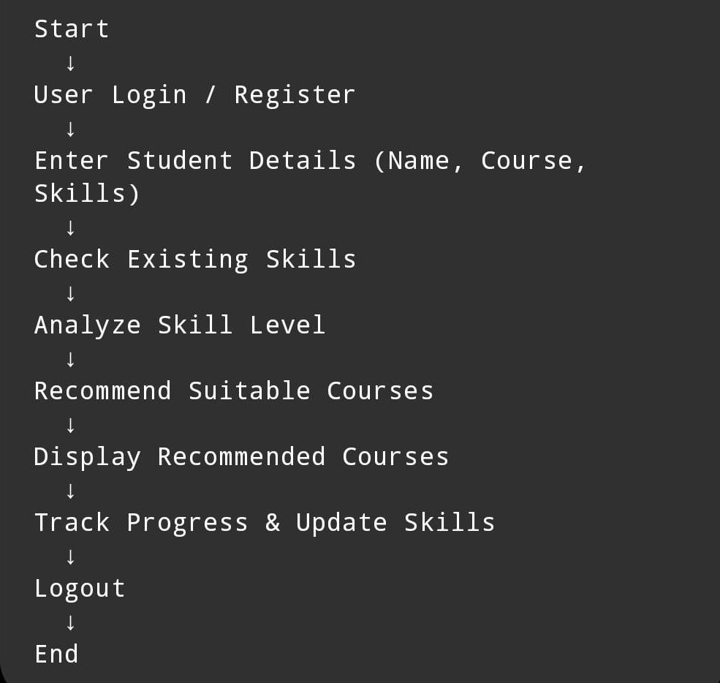
Flowchart

Slide 10
Implementation
JAVA Programming Project Presentation
Java concepts used:
Classes & Object
Arrays / ArrayList
Conditional statements (if-else)
Loops (for, while)
File handling (optional)

Slide 11
Source code
import javax.swing.*;
import java.awt.*;
import java.awt.event.*;
public class CourseRecommendationSystem extends JFrame implements ActionListener {
JLabel nameLabel, skillLabel, interestLabel, resultLabel;
JTextField nameField;
JComboBox<String> skillBox, interestBox;
JButton recommendBtn;
public CourseRecommendationSystem() {
setTitle("Course Recommendation & Skill Tracking System");
setSize(500, 400);
setLayout(new FlowLayout());
setDefaultCloseOperation(JFrame.EXIT_ON_CLOSE);
nameLabel = new JLabel("Enter Name:");
skillLabel = new JLabel("Select Skill Level:");
interestLabel = new JLabel("Select Interest:");
nameField = new JTextField(15);
String[] skills = {"Beginner", "Intermediate", "Advanced"};
skillBox = new JComboBox<>(skills);
String[] interests = {"Java", "Python", "Web Development"};
interestBox = new JcomboBox<>(interests);
recommendBtn = new JButton("Get Recommendation");
recommendBtn.addActionListener(this);

Slide 12
resultLabel = new JLabel("Recommended Course will appear here");
add(nameLabel);
add(nameField);
add(skillLabel);
add(skillBox);
add(interestLabel);
add(interestBox);
add(recommendBtn);
add(resultLabel);
}public void actionPerformed(ActionEvent e) {
String name = nameField.getText();
String skill = (String) skillBox.getSelectedItem();
String interest = (String) interestBox.getSelectedItem();
String recommendation = "";
// Recommendation Logic
if (interest.equals("Java")) {
if (skill.equals("Beginner"))
recommendation = "Learn Core Java";
else if (skill.equals("Intermediate"))
recommendation = "Learn Advanced Java & JDBC";
else
recommendation = "Spring Boot & Microservices";
}

Slide 13
else if (interest.equals("Python")) {
if (skill.equals("Beginner"))
recommendation = "Python Basics";
else if (skill.equals("Intermediate"))
recommendation = "Data Science with Python";
else
recommendation = "Machine Learning & AI";
}
else if (interest.equals("Web Development")) {
if (skill.equals("Beginner"))
recommendation = "HTML, CSS, JavaScript";
else if (skill.equals("Intermediate"))
recommendation = "React JS / Node JS";
else
recommendation = "Full Stack Development";
}
resultLabel.setText("Hello " + name + ", Recommended: " + recommendation);
}
public static void main(String[] args) {
new CourseRecommendationSystem().setVisible(true);
}
}

Slide 14
Output Screens
java
Java Programming Project Presentation
• Input screen sample
• Output / Result screen
• File storage proof (if applicable)
(Insert screenshots here)

Slide 15
Results & Discussion
JAVA Programming Project Presentation
System successfully recommends courses
Helps students choose correct path
Easy to use and efficient
Faced challenges:
Matching logic
Data organization

Slide 16
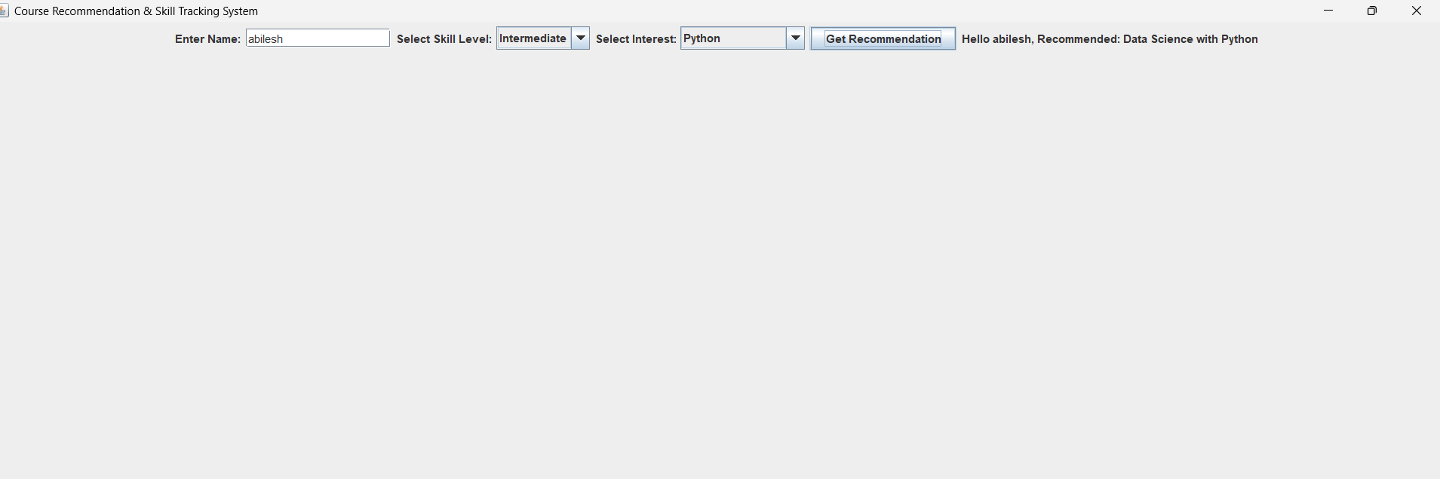
OutputScreens

Slide 17
Conclusion & Future Enhancement
JAVA Programming Project Presentation
Conclusion
Project meets all objectives
Improves student decision-making
Demonstrates Java programming skills
Future EnhancemenT
Add GUI using Java Swing / JavaFX
Connect with database (MySQL)
Use AI for better recommendations
Mobile app version

Slide 18
References / Acknowledgement
JAVA Programming Project Presentation
Java Programming – E. Balagurusamy
Oracle Java Documentation
Online tutorials (GeeksforGeeks, W3Schools)

Slide 19
Thank You
“Smart Learning Starts with Smart Choices”
Questions?
Questions & Discussions

